Slide 1
2024 – MVT Signal Acquisition with FPGA
Sadie, Adriaan

Slide 2

Technology Project - 2024 Multi-voltage thresholding (mVT) Signal acquisition with FPGA
Background
Goal & Objectives
Advantages / Drawbacks
Timeline
Required Budget
Timeline
Expected Outcome
References

Slide 3
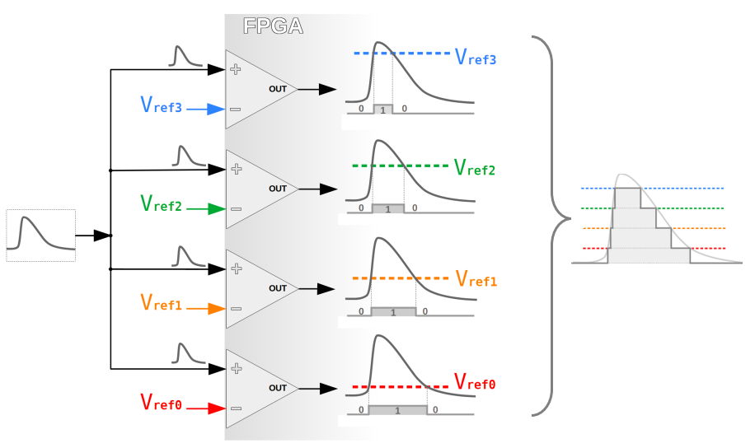
Technology Project: MVT with FPGA Background
Multi-Voltage Thresholding technique: MVT approach akin to Flash-ADCs Voltage ladder for reference voltage levels Comparators for input comparison Input signal "sliced" at voltage levels Information from comparator switching times used for signal restoration Rapid digitization capability Better voltage resolution needs many comparators Modern FPGAs feature LVDS inputs: Comparators in LVDS receivers, usable for MVT Multi-level DAC can set up voltage references Comparators have different transition and on-times Proposed IP-Core precisely acquires transitions [1] Transitions streamed out via AXI4-Stream interface

Slide 4
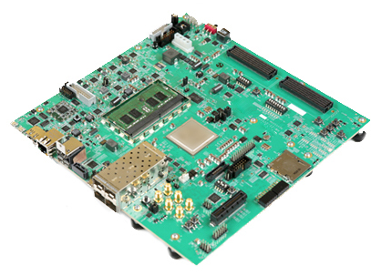
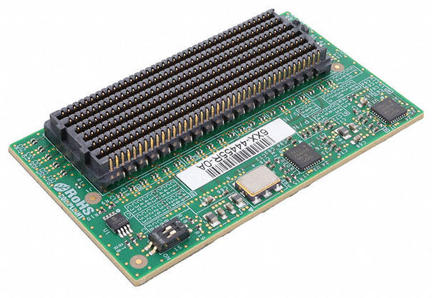
Technology Project: MVT with FPGA Goal & Objectives
 | Goal: Investigate the viability of utilizing the MVT technique on an MPSoC Zynq Ultrascale+ device and demonstrate its potential to replace ADCs in specific applications, thus validating its cost effective feasibility. For MAW400 ADCs Objectives: Design an FMC breakout board for one of the MPSoC Development Kits. Perform DAC calibration on the breakout board. Modify open-source IP core given in [1] to accommodate more inputs and, therefore, a higher resolution. Apply test analogue signals, and prove that they can be reconstructed digitally.

Slide 5
Technology Project: MVT with FPGA Advantages / drawbacks
 | Pros: Cheaper alternative for ADCs Simpler interface Avoid obsolescence issues with highly specialised ADCs Can be implemented on cheaper MPSoC FPGA devices Compared to expensive RFSoC with internal ADCs Only external component is slow, cheap, and common DAC Once-off calibration Can be used for next iteration of MAW-400, if proven Cons: Each bit n requires 2^n differential input, therefore, 4-bit ADC uses 16 differential pairs

Slide 6
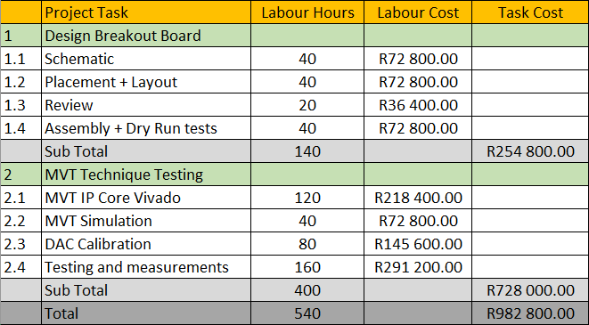
Technology Project: MVT with FPGA required Budget (for 2024)
Rough estimate:

Slide 7

Technology Project: MVT with FPGA Timeline / Schedule
Timeline
Technology projects consistently hold a lower priority compared to customer assignments.
Consequently, our intention is to utilize this as an interim task between ongoing work, with the goal of completion by 2025.
~50% time allocation for 2024/2025
Resources only from HE Group

Slide 8
Technology Plan: MVT with FPGA Expected Outcome (for 2024)
Update the open-source MVT IP Core to be generic
Prove the technique on MPSoC development kit (two dev. kits on hand in HE)
Compare results to currently used ADCs

Slide 9
Technology Plan: MVT with FPGA References
Eliseev, D., et al. "An open-sorce IP-Core for Multi-Voltage Thresholding signal acquisition with FPGAs." Journal of Instrumentation 19.02 (2024): C02035.

Slide 10

http://www.saabgroup.com
Thank You

